Slide 1

Farnborough Grange 2026
Supporting children with Makaton sign language!

Slide 2

Supporting children with communication difficulties

Slide 3
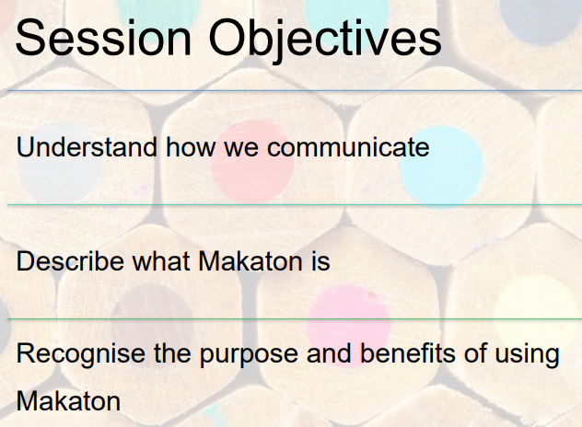

Slide 4
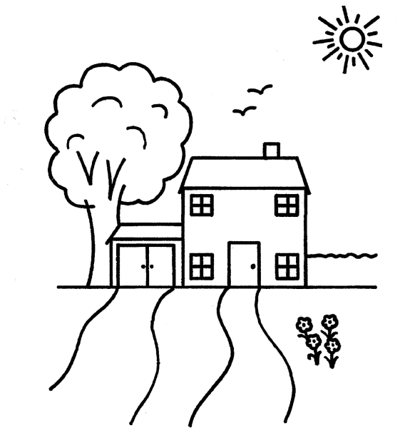

Slide 5
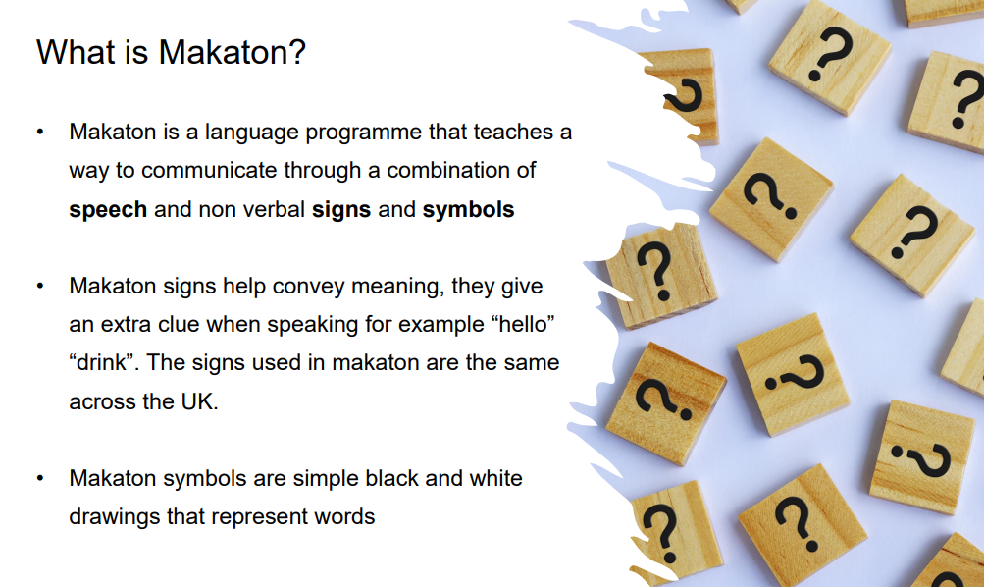

Slide 6
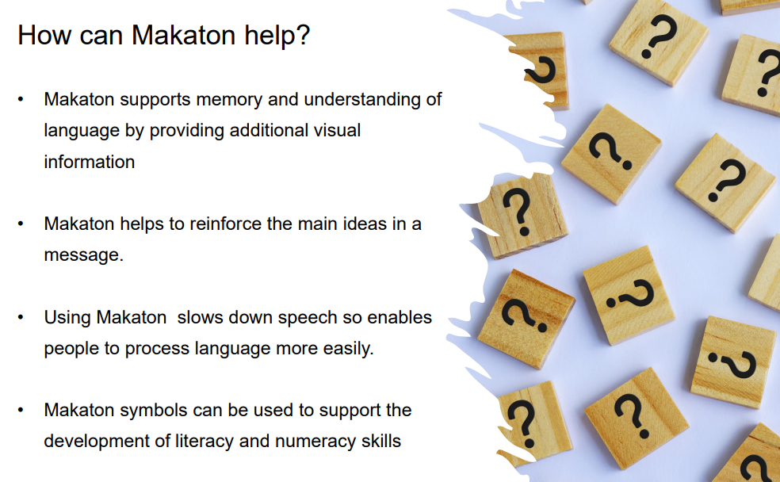

Slide 7
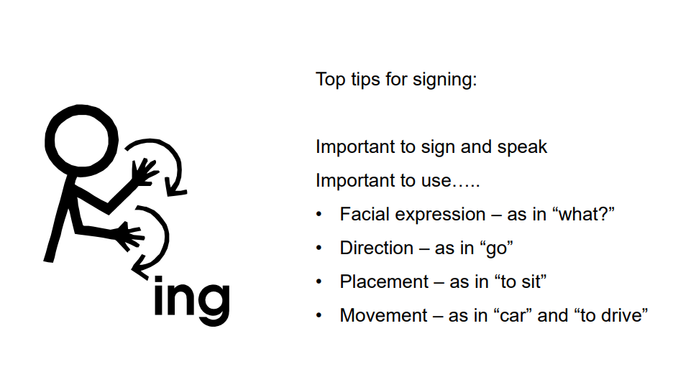

Slide 8
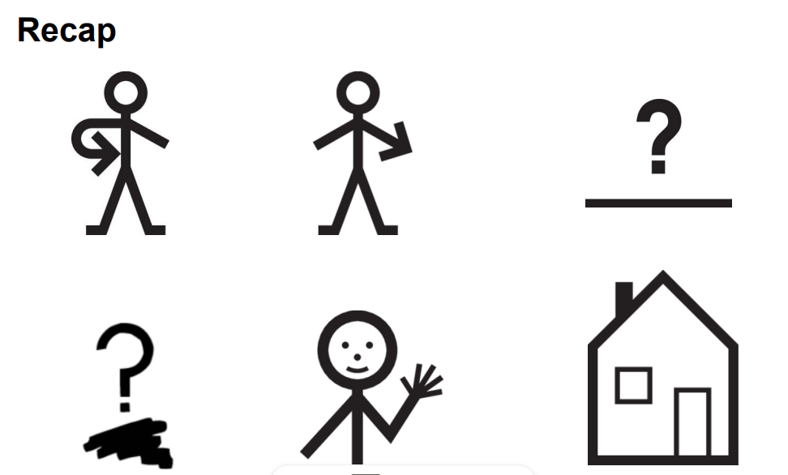
You = point to the person, me = point to self , Where = hands go around next to side in circle movement, What = one finger to the side, Hello = wave hands, House = Make a triangle/house shape.

Slide 9
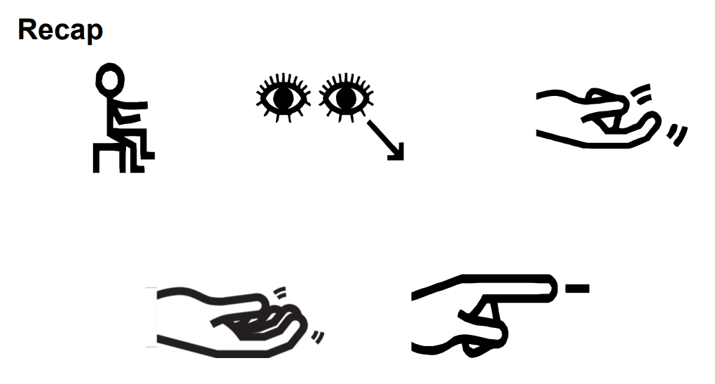
To sit = hands on top of each other and push towards the floor, to look = two finger next to eyes pointing,
come = one finger movement up, to come = fingers move movement curling forwards , to go = point in the
direction to leave

Slide 10
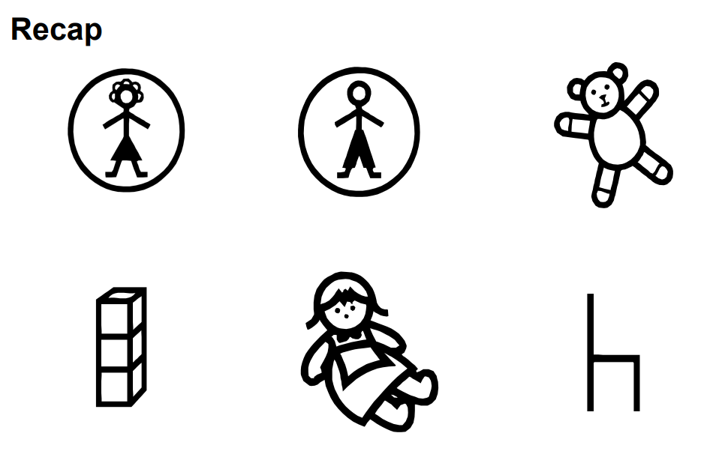
Mummy = Flat hand and three fingers on top tapping, Daddy = two fingers and two fingers tapping twice,
Teddy= hug arms around like a cuddle, bricks = small block shapes on top of each other,
doll = arms cradled like a baby, chair = two hand on top of the chair in curved shape.

Slide 11
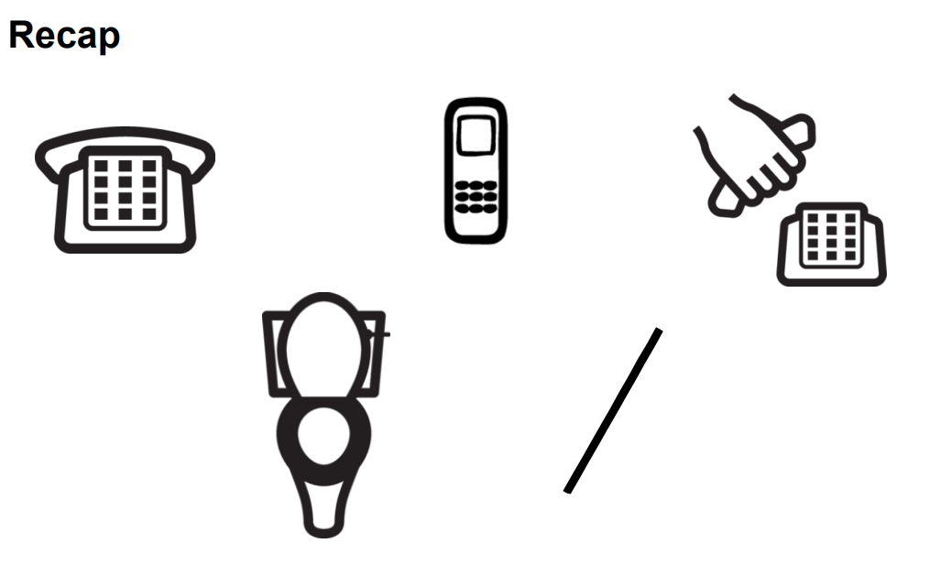
Telephone = a thumb and finger next to the ear, Mobile phone = curved hand to ear,
to phone = same a above but with movement, toilet = hand across body and third finger run across the body,
No = arm across body in a diagonal, Yes = hand in fist knocking forward.

Slide 12
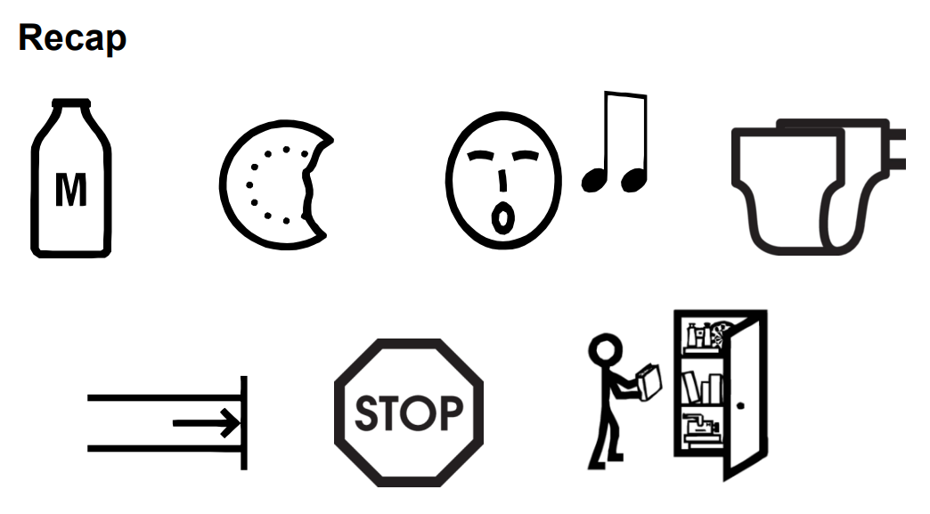
Milk = milking a cow movements, Biscuit = touch elbow with hand in a round shape twice,
Sing = Hands up from mouth in a circular shape, Nappy = two fingers on hips then move to the front on body,
Finish = hands in fist and the open out and push down, stop = hand in the air flat, tidy up = two hands up around
a box and make 3 movements across

Slide 13
Useful Websites to learn new signs for Makaton:
https://youtu.be/1aqkjSMmc9Y
https://youtu.be/flXsU4V0zz8
https://youtu.be/VawNRu5gmTM

Slide 14
Thank you for coming!
Any Questions?

