Slide 1
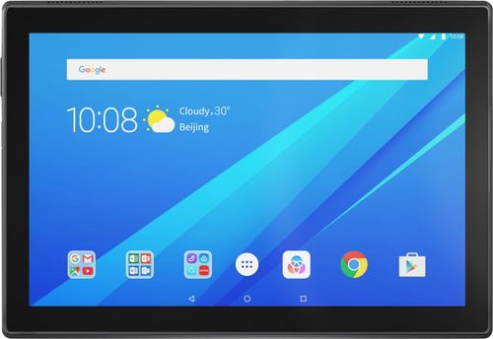
E-Safety
How can we keep your children safe online?

Slide 2
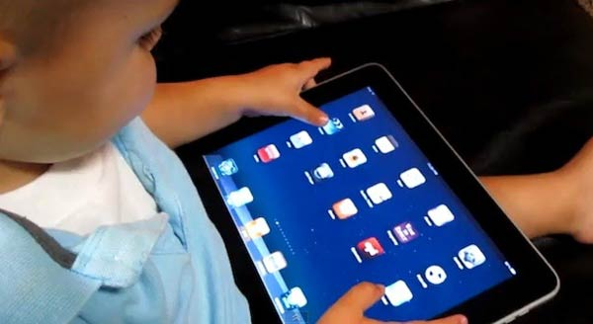
Did you know?
Over half of 3-4 year olds use tablets.

Slide 3
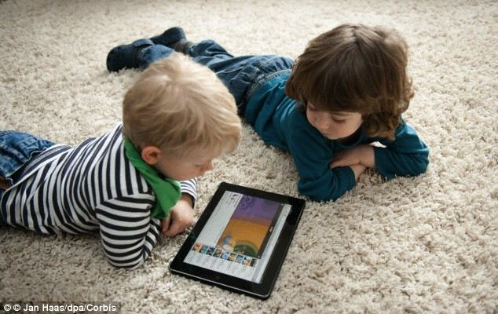
Did you know?
Pre-school children are online for an average of 71 minutes a day.

Slide 4
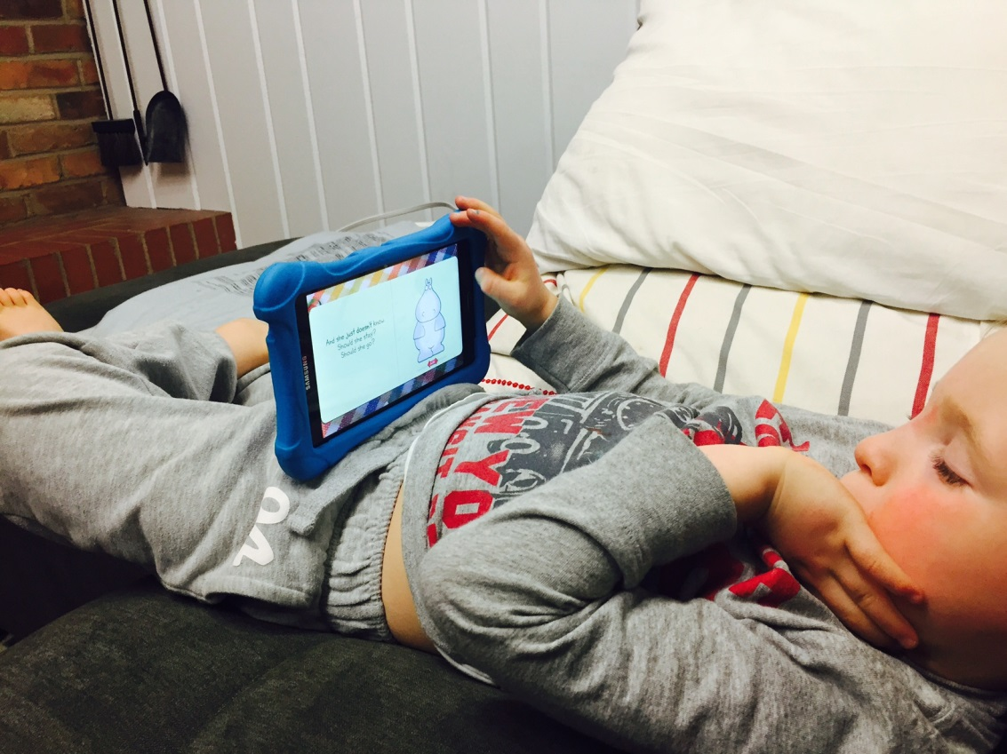
Did you know?
1 in 3 children now own a tablet, and 71% live in a house with a tablet.

Slide 5
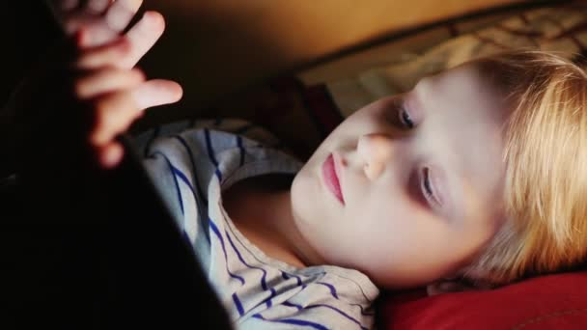
Did you know?
Over 65% of parents are concerned about their 6-10 year olds viewing inappropriate content online.

Slide 6
Did you know?
Some children between the ages of 4-7 spend nearly 3 hours a day online.

Slide 7
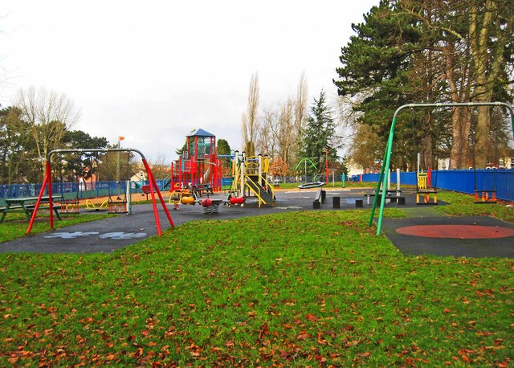
Did you know?
Obesity levels are rising. Children are becoming less active and more addicted to their online devices.

Slide 8
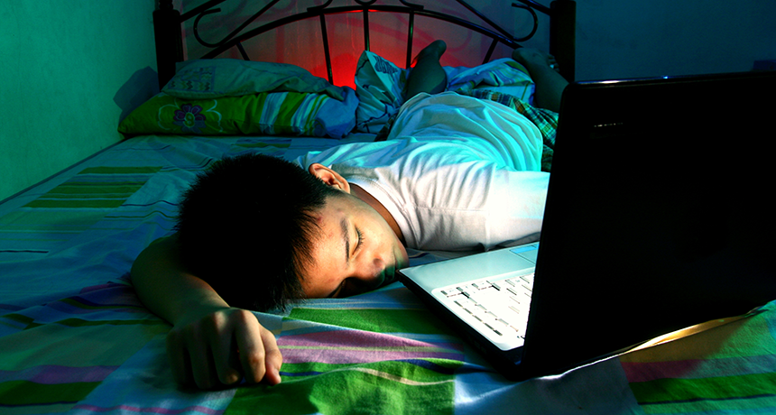
Did you know?
Screen time before bed can stop children from developing good sleep routines.
It can delay sleep time and reduce the amount of sleep a child gets.

Slide 9
So what can we do to keep them safe?
Explore their online world together.
Check that games and apps are suitable.

Slide 10
So what can we do to keep them safe?
Talk to your child about what they do online.
Starting conversations early will help them to talk more openly as they get older.

Slide 11
So what can we do to keep them safe?
Supervise your child’s use of their devices.
Young children should not access the internet unsupervised e.g. in their bedroom.

Slide 12
So what can we do to keep them safe?
Put parental controls on all devices that your child has access to.
More advice about parental controls can be found on the NSPCC Website.

Slide 13
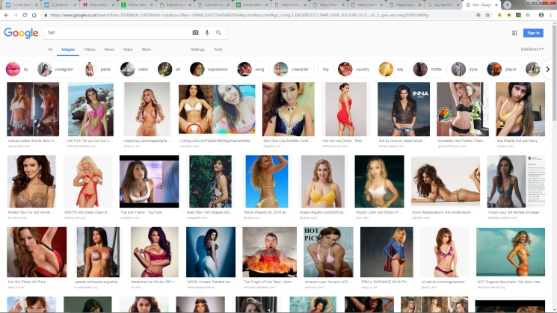
So what can we do to keep them safe?
Don’t trust the website your child is on.
Sometimes, an innocent search can bring up unwanted and unexpected results!

Slide 14
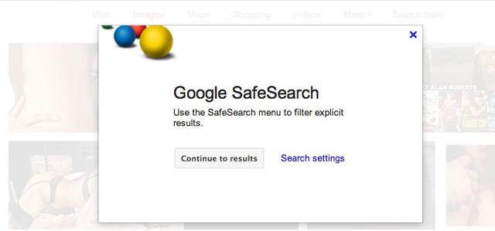
So what can we do to keep them safe?
Use the ‘Safe Search’ function.
This can be set up on websites like Google, but remember, it is not 100% effective.

Slide 15
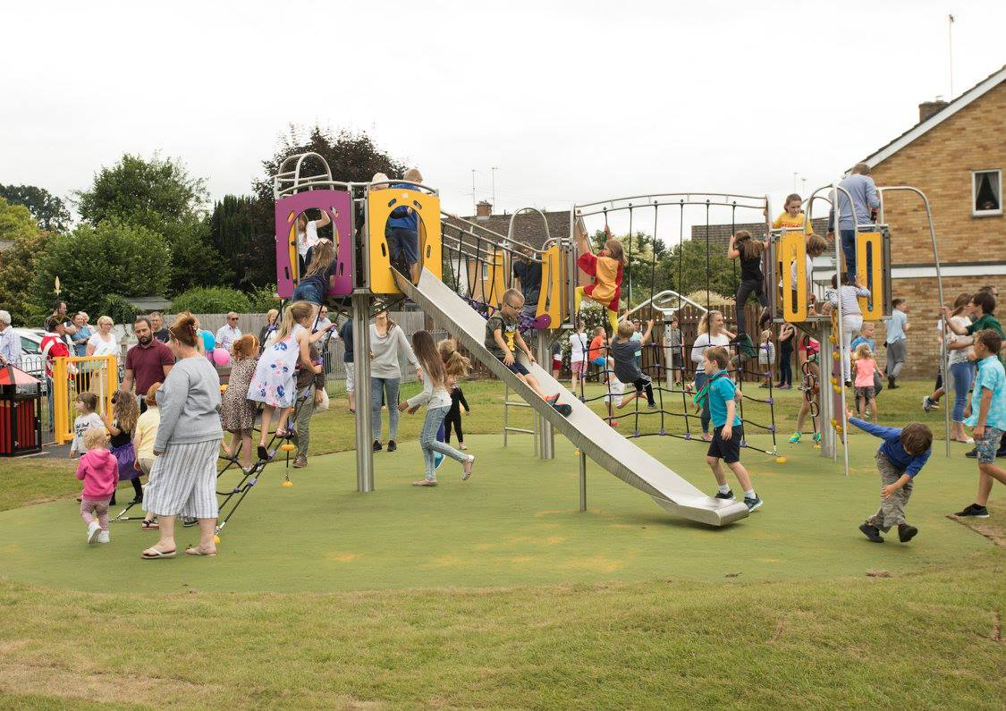
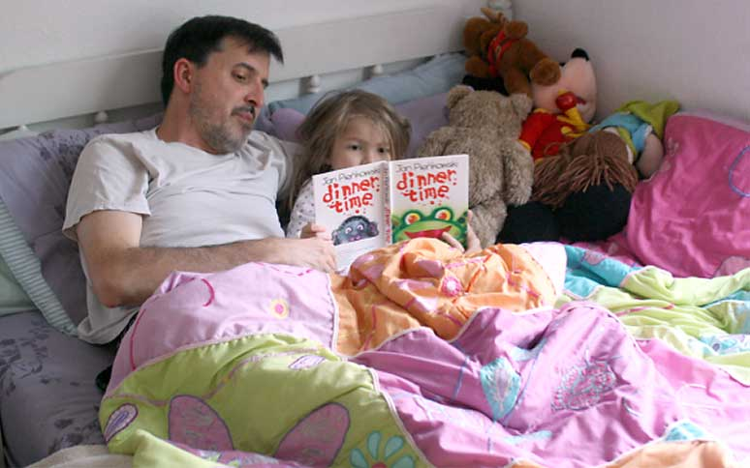
So what can we do to keep them safe?
Limit their screen time.
Make time for reading stories, playing games and getting outdoors.

Slide 16
So what can we do to keep them safe?
Make them aware of stranger danger.
Do they know who they are talking to?
Do YOU know who they are talking to?

Slide 17
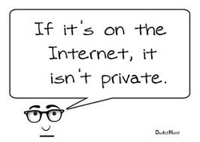
So what can we do to keep them safe?
Talk to them about what is okay to share online.
Are they sharing too much information?
Lee and Kim

Slide 18
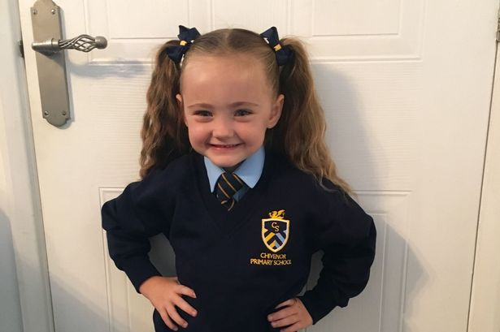
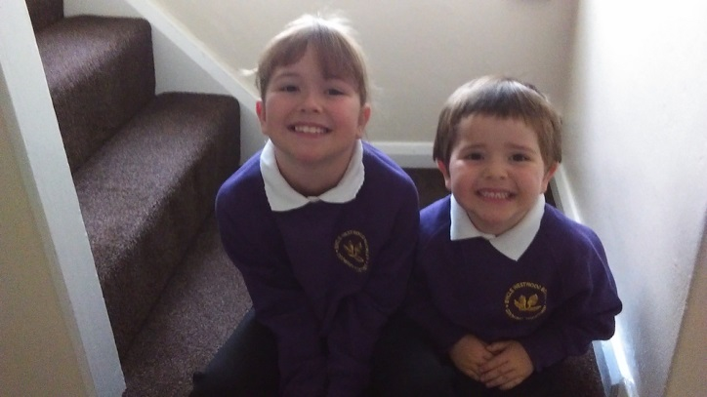
So what can we do to keep them safe?
Talk to them about what is okay to share online.
Are YOU sharing too much information?
What is the difference with these two photos?

Slide 19
So what can we do to keep them safe?
Be a good role model and model the digital habits you expect.
Show when it is okay and not okay to use devices e.g. no tablets during meal times.

Slide 20
So what can we do to keep them safe?
Check the Age Ratings on all games.
They are there for a reason!

Slide 21
So what can we do to keep them safe?
Check the minimum age limits on Social Media Websites.
They are there for a reason!
13
13
13
13
18

Slide 22
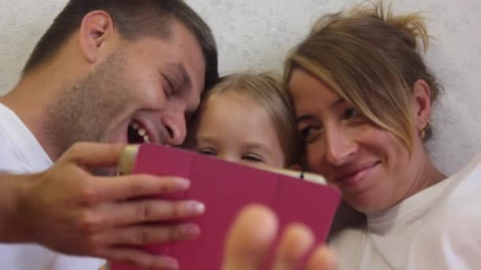
Remember…
Used and monitored correctly, the online world can be an exciting one for our children to share.
Just be vigilant!

Slide 23
Finally…
Do you have any questions?

