Slide 1
Maths
How to help at home

Slide 2
What are the key areas of Mathematics?
Number and Place Value
Multiplication and Division
Fractions
Measurement – Money, Time, L & H, M & V
Geometry – Shape and Position
Addition and Subtraction

Slide 3
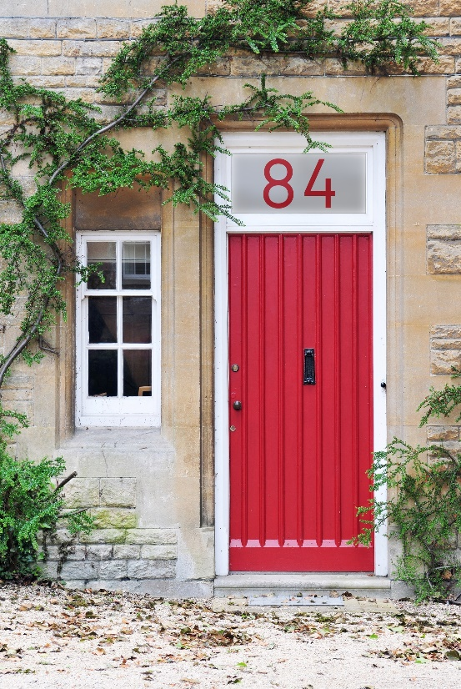
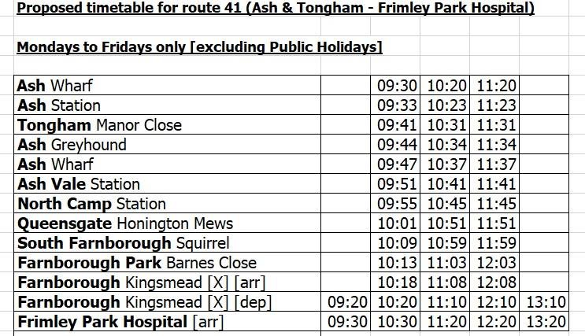
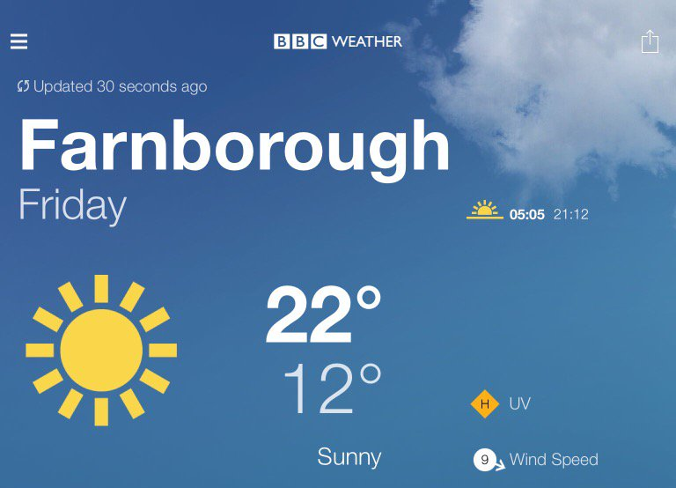
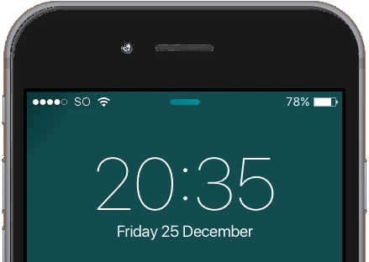
Maths in Everyday Life

Slide 4
How can you help at home?
Baking

Slide 5
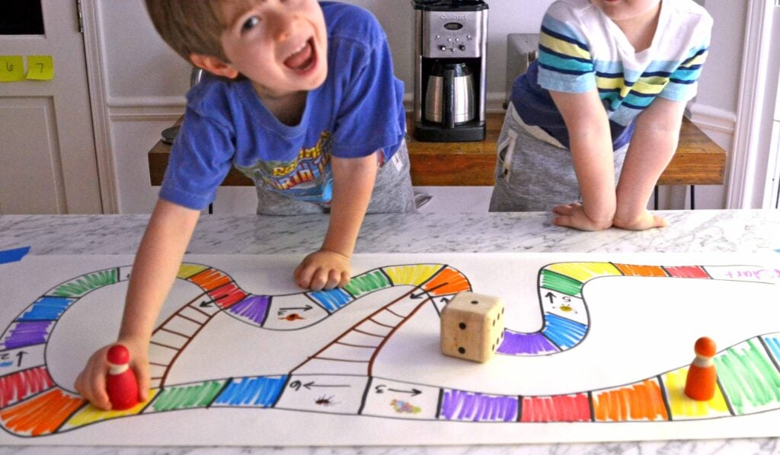
How can you help at home?
Board games

Slide 6
How can you help at home?
Telling the time

Slide 7
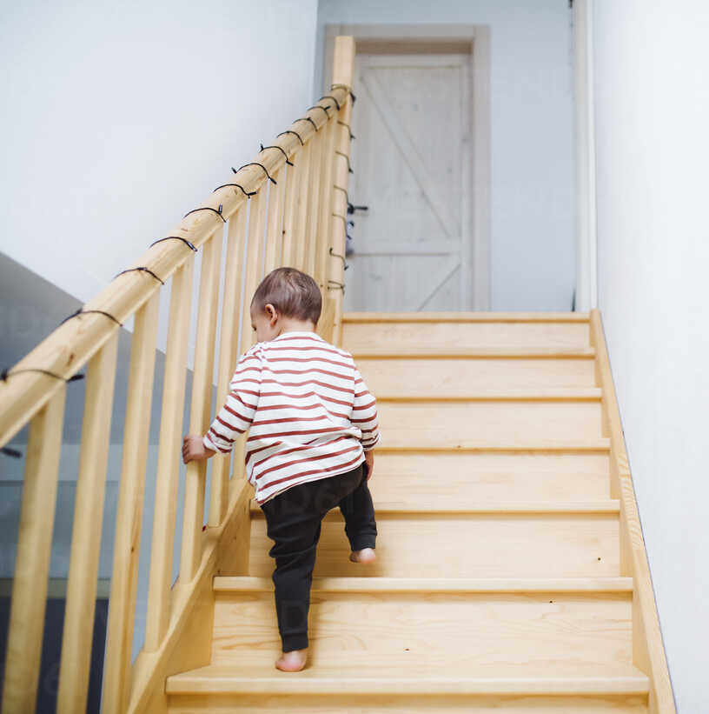
How can you help at home?
Counting everyday

Slide 8
How can you help at home?
Find shapes in the environment

Slide 9
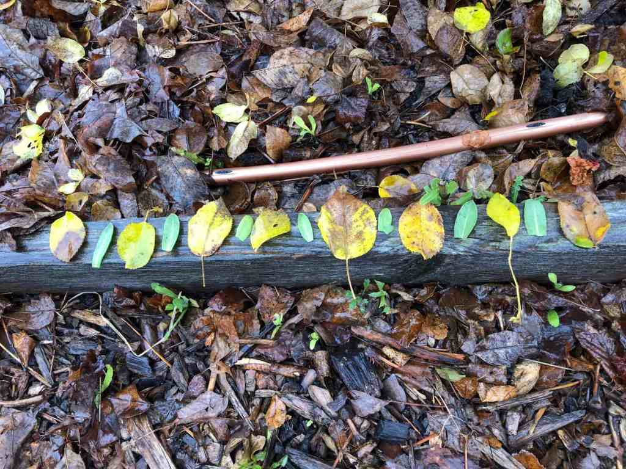
How can you help at home?
Find patterns in nature

Slide 10
Positive Mindset
Don’t worry! Maths doesn’t have to be complicated.
Show your child that Maths is fun.
Build it into everyday life.
Talk positively about Maths to build a love of number for your child.
We are all Mathematicians!

Slide 11
Any questions?

